Slide 1
Why we should include TypeScript in our development process
William Jackson
Student ID: 002982231
D339: Technical Communication (WGM2)

Slide 2
Agenda
What is TypeScript
The benefits to our company from adopting TypeScript

Slide 3
What is TypeScript
Superset to JavaScript
  “a type system is one way you can reason about your code. It's the ability to check your code before you run and deploy it. Without types in a language that's almost impossible.” (Hejlsberg in Tung, 2020).
How it works
  Transpiles to JavaScript
  Erases all type signatures and other TypeScript features
Recently added features
  Private fields, type-checks of import/export statements, decorators (Rosenwasser, 2020, 2023)
Notes:
Superset:
- TypeScript is a language that builds on JavaScript by adding types signatures to interfaces, functions and variables which can be used for type-checking
- To quote the co-creator: “a type system is one way you can reason about your code. It's the ability to check your code before you run and deploy it. Without types in a language that's almost impossible.” (Hejlsberg in Tung, 2020).
How:
When executing the build step from TypeScript to JavaScript, the TypeScript engine will examine if there is any possibility that a parameter or a variable is assigned an unexpected data type that contradicts its signature. If this is the case, the build process will record all type errors and print them as a descriptive error list for the developer to address before attempting another build. Only when all type errors have been corrected will the TypeScript file build step complete. It’s worth nothing that it renders a clean JavaScript file free from type notations or any other TypeScript feature (Jansen et al., 2016) .
Recent features:
Of recent noteworthy additions worth mentioning, version 3.8 introduced private fields to aid with data security as well as type-checking to import and export statements (Rosenwasser, 2020), while the latest version 5.0 includes decorators to allow customization of classes and methods (Rosenwasser, 2023).

Slide 4
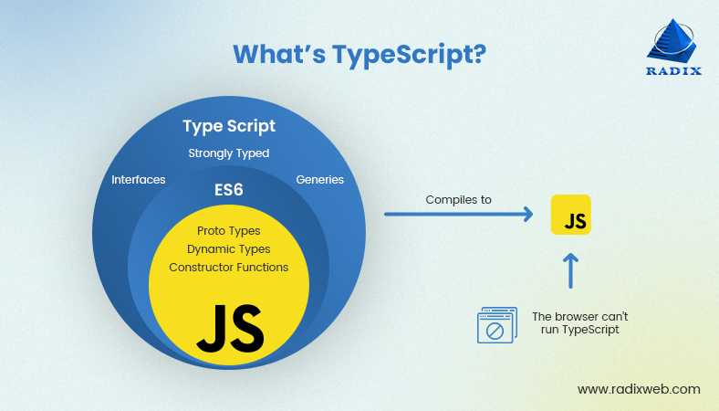
Image Credit (Raval, 2023)
Notes:
This image illustrates the relationship between TypeScript and JavaScript.
ES6 added new features to JavaScript, and ES6 can be transpiled to older JavaScript code to ensure compatibility with older browsers.
Similarly, TypeScript takes all ES6 features and adds strong types, interfaces, enums and other features, which then converts to JavaScript for the browser to run (you can chose which JavaScript version to compile to, ES6 or an older version). TypeScript by itself cannot run in the browser.

Slide 5
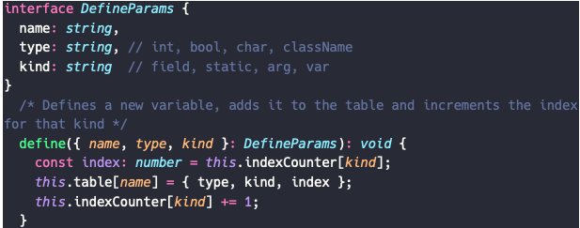
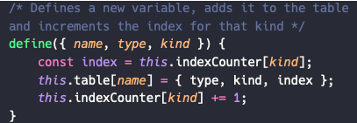
The benefits to our company from adopting TypeScript
Type-checking
  Reduces the number of type errors in our code to near zero
TypeScript (my own example)
JavaScript (my own example)
Notes:
This TypeScript file contains an interface called DefineParams that specifies its three properties and the types for each. This interface is then declared as the parameter for the define method, which may under no circumstance return a value due to the specified void return signature. If the define function receives an argument that does not implement the DefineParams interface, it will raise an error in the build process.
This JavaScript file version of the same function, on the other hand, merely names the three properties without specifying their types, which leaves the function vulnerable to bugs if it receives an argument with an incompatible type

Slide 6
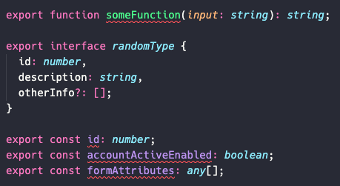
The benefits to our company from adopting TypeScript
Easier to understand and maintain code
  Forces developers to explicitly state use cases
  Signatures and Declaration files
Declaration file (my own example)
Notes:
Until now, we’ve had to rely on the individual developer writing helpful comments above each function or statement to aid others as well as their future selves in extending or debugging that section of code. Such comments, however, have not followed a standard and have oftentimes been lacking in specificity, which has caused considerable time wasted in trying to grasp and run the code.
With TypeScript’s type annotations, we can enforce a standard signature that provides transparency in the inputs and outputs for all functions as illustrated in the TypeScript file example in the previous paragraph. As an added benefit, all interfaces, classes, functions, and variables can be automatically collected in a declaration file as part of the build step to provide a convenient overview, as you can see in this declaration file
Between the signatures and the separate declaration file, TypeScript marks a significant improvement in readability and maintainability over plain JavaScript.

Slide 7
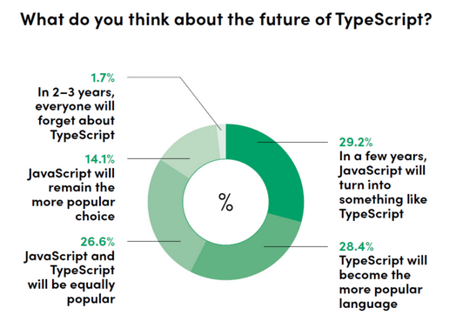
Bonus benefit: Future proofing the company
Image credit (Kubiak, 2023)
Notes:
Over half believe that either TypeScript will become more popular or that JavaScript will turn into something like TypeScript.
Twice as many believe that TypeScript will be more popular as compared to JavaScript remaining the more popular choice.
This will improve the productivity of our engineers and aid our recruitment efforts by branding our company as one that utilized the latest, cutting-edge developer methodologies and tools. Let’s take that leap!

Slide 8
References
Kubiak, G. (2023). Why use TypeScript? Could it be the best way to write frontend in 2023?. Retrieved October 31, 2023, from https://tsh.io/blog/why-use-typescript/
Raval, N (2023). TypeScript vs JavaScript: The Difference You Should Know. Retrieved November 1, 2023, from https://radixweb.com/blog/typescript-vs-javascript
Rosenwasser, D. (2020). Announcing TypeScript 4.0. TypeScript. Retrieved October 31, 2023, from https://devblogs.microsoft.com/typescript/announcing-typescript-4-0/
Rosenwasser, D. (2023). Announcing TypeScript 5.0. TypeScript. Retrieved October 31, 2023, from https://devblogs.microsoft.com/typescript/announcing-typescript-5-0/
Tung, L. (2020). TypeScript creator: How the programming language beat Microsoft's open-source fears. ZDNET. Retrieved October 31, 2023, from https://www.zdnet.com/article/typescript-creator-how-the-programming-language-beat-microsofts-open-source-fears/

